Slide 1
16-3 The Federal Reserve & Monetary Policy
Goals:
Describe how the federal reserve and the banking system can create money.
Explain how the Federal Reserve uses reserve requirements, interest rates & open market operations to carry out monetary policy.
3. Explain why some monetary policy tools are favored over others.
4. Explain the role of monetary policy in the Economy

Slide 2
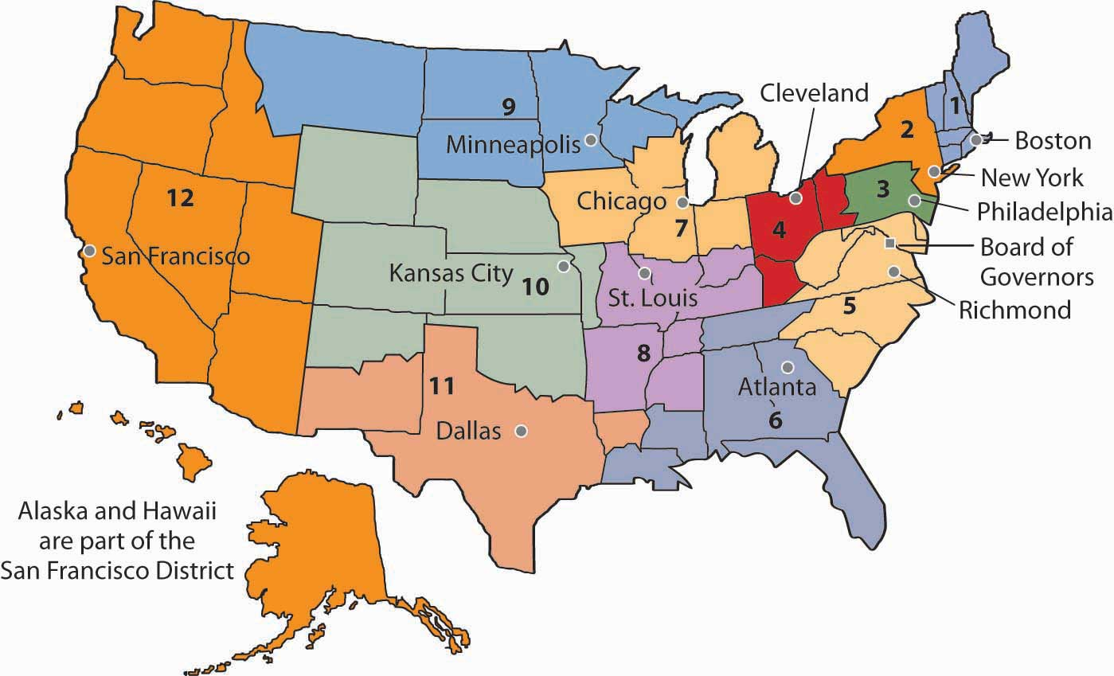
Federal Reserve System
Basic Overview
(Read the textbook handout)
Comprised of Commercial Banks – National Banks are required to belong, state banks have choice
Member banks buy “stock” of corporation
Board of Governors is appointed by Pres, apprvd by Senate and serve 14 yr terms (staggered every 2 yrs)
12 District Banks and 25 branch banks serve the Member Banks

Slide 3
Federal Reserve System cont.
FOMC- Federal Open Market Committee
Makes decisions about the money supply and interest rates – comprised of 7 members of the BoG, Pres of NY District Bank, and 4 other District Bank Presidents (1 yr terms)
FAC- Federal Advisory Council – representatives from all 12 district Banks who advise the Fed. Res. on overall economic matters
Responsibilities of the Fed
-Set interest rates -Regulate Foreign Banks
-Maintain Money Supply -Approve State Bank Mergers
-FDIC- Reserves -Check Clearing/Truth in Lending
-Regulate Holding Companies -Federal Gov’t’s Bank

Slide 4
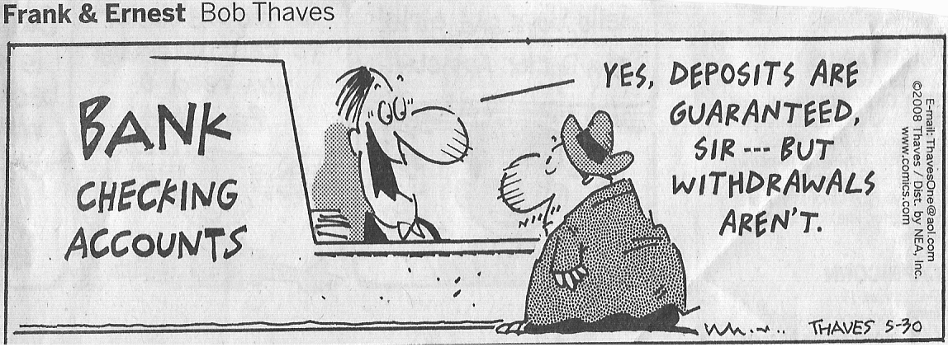
Money Creation
Money Creation ≠ Printing Money
– process by which money enters into circulation as a result of the actions of financial institutions and the Federal Reserve
Required Reserve Ration (RRR) – percentage of deposits that must be set aside as insurance for banks as determined by the Federal Reserve

Slide 5
How Banks Create $$$

Slide 6
Money Multiplier Formula
Increase in Supply = deposit X 1/RRR
So… $1000 at a RRR of 10% = $10,000 new money
Theoretically Speaking..
Sometimes, people hold money on their own out of the system, and sometimes…
Excess Reserves – when banks hold out more than required amount as a safeguard

Slide 7
How the Federal Reserve affects Money in Circulation (Monetary Policy)
3 Tools the Fed uses to change the amt. of $ in circulation:
Reserve Requirement Ratio
Interest Rates
Open Market Operations

Slide 8
Tools of the Federal Reserve
1. Adjusting the RRR (Reserve Requirement Ratio)
Reducing the RRR = frees up $$ for banks to make more loans, and increases the Money Multiplier
more money in circulation
Increasing the RRR = banks must hold back more in reserves, less loans, smaller Money Multiplier
less money in circulation
(Rarely happens as the banks would have to call in loans and would negatively affect the public)
Inverse Relationship

Slide 9
Tools of the Federal Reserve
2. Setting Interest Rates
Federal Funds Rate – rate at which banks loan $ to each other
Discount Rate – rate at which the Federal Reserve loans $ to banks
The Fed keeps the Discount rate higher than the Federal Funds rate so that the banks go to each other first, the Fed wants to be the back-up
The rates that the banks pay affect the Prime Rate – the rate the banks charge their best customers and the basis for most other loan rates
Low interest rates = more borrowing/less saving- Money Supply
High interest rates = less borrowing/more saving- Money Supply

Slide 10
Tools of the Federal Reserve
3. Open Market Operations
-buying and selling of government securities (T-bonds, T-bills etc. ) on the open market -most used and most effective tool of the Fed
Bond Purchases- buying back of securities from the public = increase in $ supply
Bond Selling – releasing securities into the open market for public purchase = decrease in $ supply

Slide 11
Counting down the Feds Tools
3. Adjusting the RRR is least desired as it would have the greatest effect on the banking system
2. Setting interest rates is used but infrequently – Fed tries to keep its rates in line with rest of the economy to keep banks from over-borrowing
1. Open Market Operations is used the most as it is very effective and least disruptive to banks and public

Slide 12
Role of the Monetary Policy in Economy and Politics
The Fed must react to and predict trends in the economy – but policies take time to work
Timing of actions and the lag time can create problems and affect the public perception of effectiveness of the policy
This is why economy plays such a large role in politics as it is the politicians who appoint the Board of Governors and set the rules outlining the Feds authority

